Slide 1
Economics
Australia’s trade with other nations

Slide 2
Copy down the content highlighted in green in your hass notes

Slide 3
Learning Intentions
Describe International trade and its importance and benefits to the Australian economy.
Explain how trading directions can change with time.

Slide 4


International Trade
International trade occurs when nations buy, sell or trade goods and services with one another.
Many small and open economies are dependent on international trade to maintain standards of living, e.g. Singapore, Australia.

Slide 5

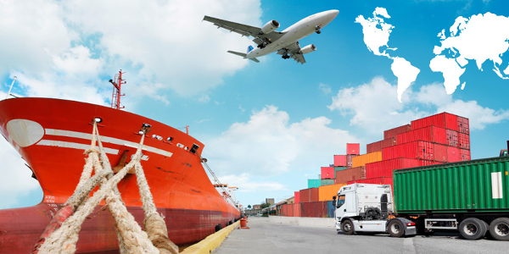
International Trade
There are several reasons why international trade is necessary, such as the uneven distribution of natural resources and climatic factors.
Economics should therefore utilise the resource with which they are endowed and specialise in those areas

Slide 6


Activity
Use BOLTSS to label your map. (a blank map of the world is provided)
Locate Australia’s top 10 trading partners on the map and shade them in. Refer to ‘Australia’s top 10 two way trading partners.
Number each country in order from highest to lowest.
Include the value, in dollars, of the total goods and services exchanged between the countries

Slide 7
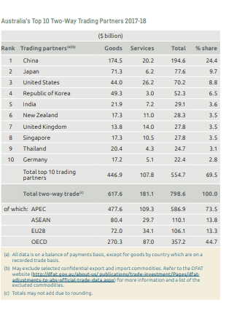

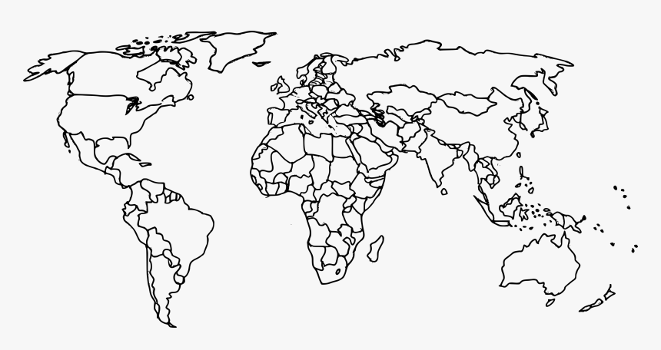
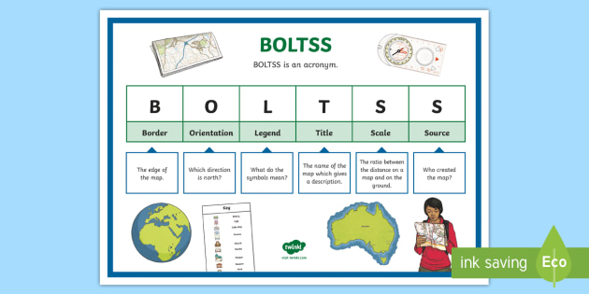

Slide 8
Open Economy
Australia is often described as having an open economy because it participates in trade with other countries.
Notes:
Reference Pearson HASS textbook 9

Slide 9
This trade involves both exports and imports.
From Australia’s perspective, an export is a good or service made in Australia but sold to residents of another country.
This results in money flowing into the Australian economy.
For example, if a person in the United States buys a pair of Australian-made sheepskin boots, the boots are described as exports from Australia to the US as money flows from the US to Australia to pay for them.
An import is a good or service made in another country that is sold to Australian residents.
This results in money flowing out of the Australian economy.
For example, if someone in Australia buys clothing online from a Chinese firm, the clothes are imported to Australia from China. The payment for those clothes flows from Australia to China.
Notes:
Reference Pearson HASS textbook 9

Slide 10
Imports vs. Exports
Imports – goods manufactured in other countries and brought into this country.
Exports – goods produced in Australia and sold to both consumers and producers in other countries.

Slide 11

Imports
Imports allow Australian consumers to get goods at a lower price as it may be more cost effective to do so.
Australian manufacturing has declined in the last 30 years due to the cheaper imports from local Asian countries.
Highly specialized machinery is also imported which may help a local business remain their ability to produce a good at a lower cost.

Slide 12
Exports
Overseas consumers can improve local businesses if they produce a product that is in demand overseas.
Over 1.7 million jobs in Australia are either directly or indirectly related to exports.

Slide 13
Trade
Goods bought from overseas by consumers in Australia causes money to flow out of the country.
Goods sold to other countries help bring money back into the Australian Economy.
Trade Surplus – When the money coming into the country is greater than the money going out.
Trade Deficit – When the money coming into the country is less than the money going out.

Slide 14
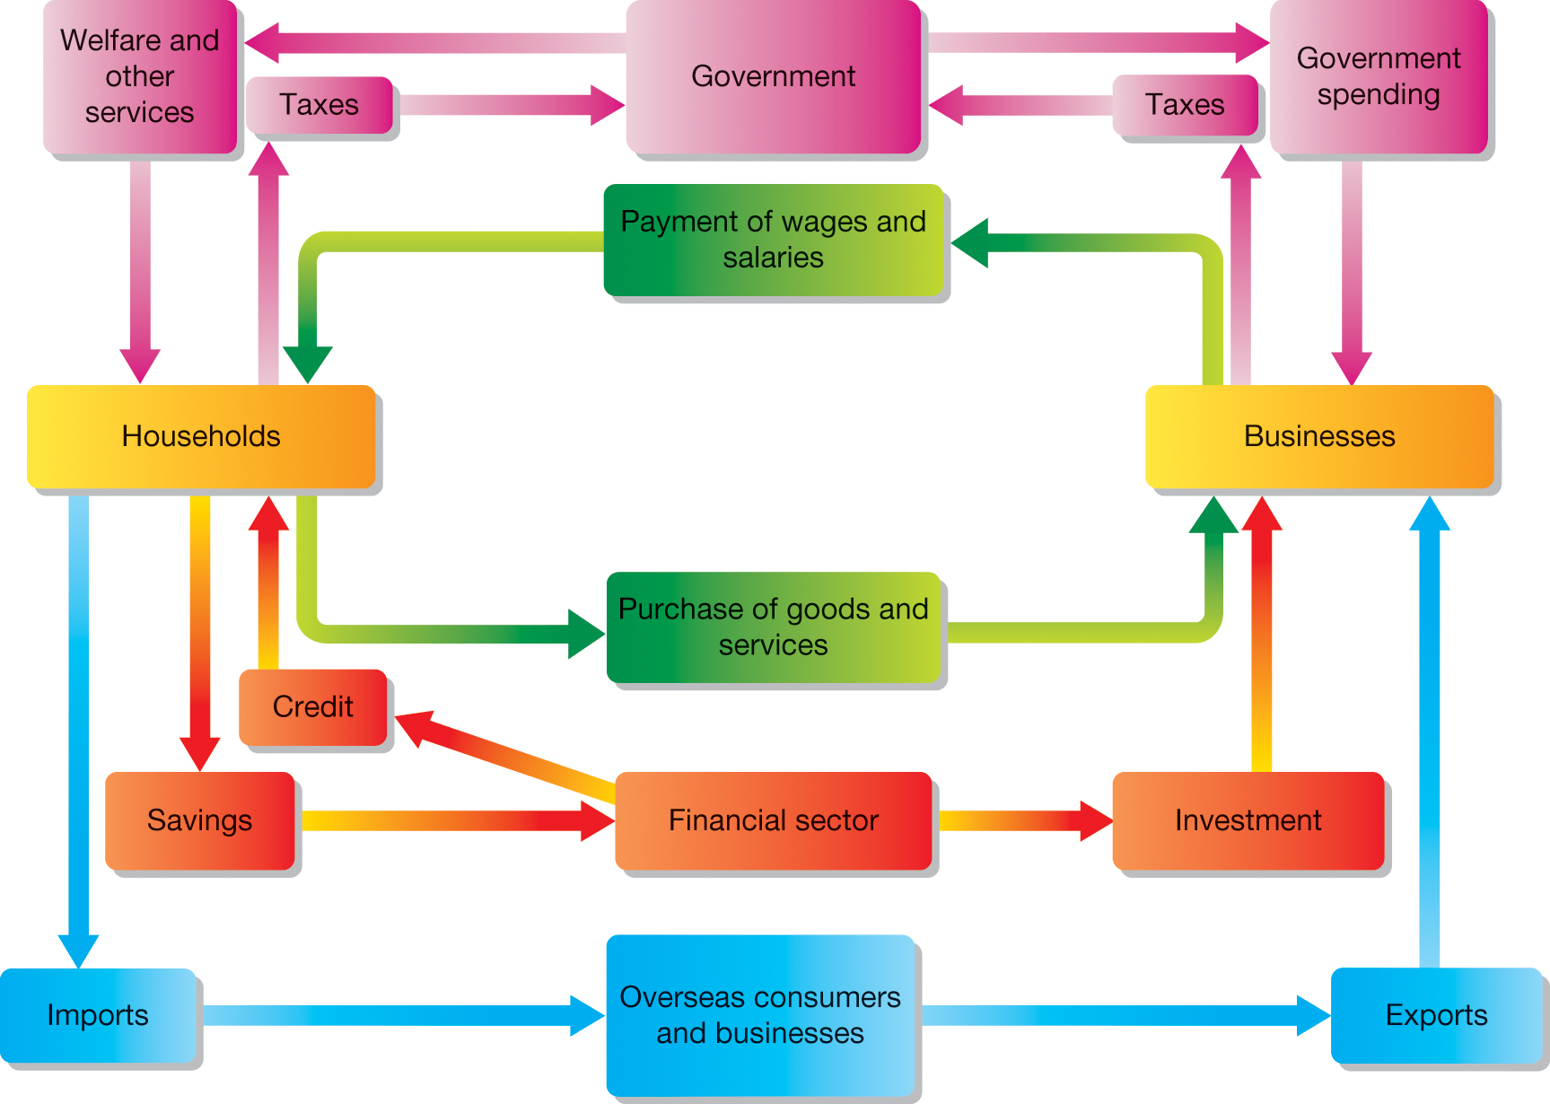

Slide 15
Australia and Asia
4 out of 5 of our top trading partners are Asian nations.
83% of Australian exports go to nations in Asia.
Export rank | Country | % of exports
1 | China | 28.3
2 | Japan | 14.6
3 | United States | 6.5
4 | Republic of Korea | 6.4
5 | India | 4.0
Import rank | Country | % of exports
1 | China | 17.4
2 | United States | 12.9
3 | Japan | 6.2
4 | Singapore | 4.8
5 | Republic of Korea | 4.2
Asian countries are very important in Australia’s trade relationships as shown in the data above.
Notes:
Reference Pearson HASS textbook 9

Slide 16
Direction of Trade
The term ‘direction of trade’ refers to the countries Australia trades with. Asia is very important in Australia’s trade relationships: four of our top five export markets and import sources are in Asia.
China is now Australia’s top trading partner by a significant margin.

Slide 17
Changes in the direction of trade
During the 20th century, Australia’s direction of trade changed considerably.
Until the 1960s, the vast majority of Australia’s trade was with the United Kingdom, mainland Europe and the United States.
This reflected, patterns of economic development at the time, but also Australia’s cultural and historical links with the English speaking powers.
From 1958, many European nations joined the European Economic Community with the aim of fostering trade and other links between countries in Europe.
At the same time, Japan was starting to emerge as a significant market for Australian products.
This began a transition from a European focus to an Asian focus in Australia’s direction of trade.
This change allows Australia and Asia to exchange items for consumers and firms of each country.

Slide 18
Importance of China and India
China’s rapid growth and development, beginning in the 1980’s, led to increased demand for Australia’s exports.
In late 2007, China overtook Japan to become Australia’s largest trading partner.
Growth of India’s economy also had a significant shift on Australia's direction of trade.
Incomes in India are also rising leading to increase demands for many of Australian exports.
As a result, India’s importance in Australian’s trade relationship is likely to rise over next few years.

Slide 19
Composition of Trade
The composition of trade is the combination of goods and services that we export and import.
Australia’s key exports recently have been natural resources, including iron ore and coal, education and tourism.
Australia’s imports have been overseas travel, oil products and high-tech items.

Slide 20
Changes in the composition of trade
From 1870s until 1960s, wool was out main export as farmers expanded operations in the large areas of land suited to raising sheep, and international prices remained strong.
In 1960s, wool prices fell due to new synthetic fibres such as nylon became more widely used.
Although, agricultural products including wool, wheat and beef are still important exports for Australia but have been overtaken by minerals (iron ore, coal and natural gas- as Australia has the largest and highest quality deposits of these items in the world and is able to mine them relatively cheaply) and services.
Australia’s main imports have been manufactured goods such as cars as it is cheaper for Australia to buy cars from other countries.
Trade in services such as tourism has grown since it’s cheaper and easier to fly to and from Australia.
Education is also an important trade item as students from overseas come to Australia to study, creating an export for Australia as money flows from other countries into Australia.
There is also large numbers of Australians who choose to study overseas, creating an import for Australia.

Slide 21
Activity: Answer the following questions.
1. State the meaning of the term ‘Open Economy’?
2. Distinguish between exports and imports.
3. Identify Australia’s three most important trading partners.
4. Describe the changes in Australia’s direction of trade since the 1960s.
5. Illustrate the importance of China to Australia’s economy.
6. Develop an argument about an area in which Australia could strengthen its economic performance in relation to trade.

Slide 22
Success criteria
Identify Australia's trade partners.
Define imports and exports and explain how they relate to the Australian Economy.

